Slide 1


Advanced Applications of Systems Modeling &Simulation
Dr. Xueping Li
University of Tennessee, Knoxville

Slide 2
Case Study #1
A Single Server System

Slide 3
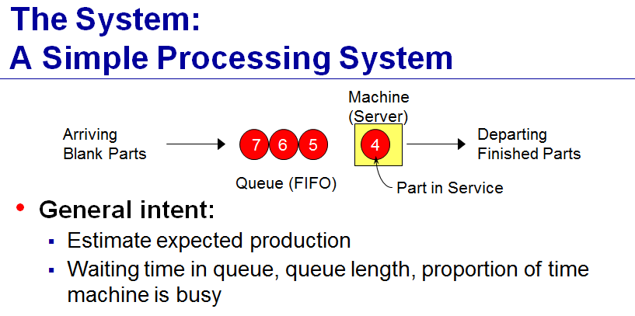
M/M/1 – Like system

Slide 4
Parameters
Incoming entities/parts
On average, every 5 minutes a part arrives
Service time
Triangular (1, 3, 6)
Introduction to probability distributions
HOW-TO: Help menu

Slide 5
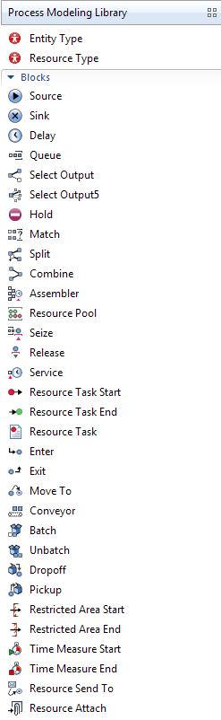
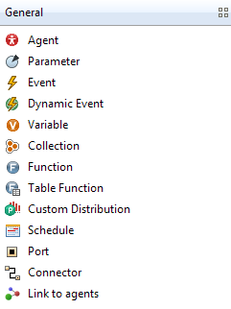
Modules/Toolboxes to learn
Process Modeling Library
Source
Queue
Delay
Sink
Select Output
Time Measure Start/End
General
Variable

Slide 6
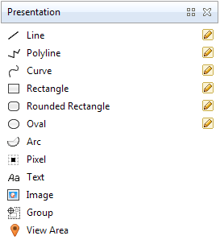
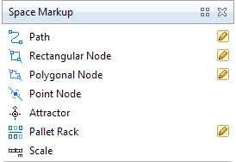
Modules/Toolboxes to learn (cont.)
Presentation
Text
Image
View Area
Space Markup
Path
Rectangle Node
Point Node
Attractor

Slide 7
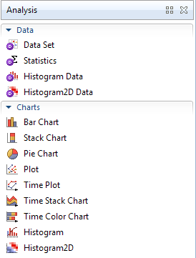
Modules/Toolboxes to learn (cont.)
Analysis
Data
Statistics
Charts
Time Plot
Bar Chart
Histogram

Slide 8
Phase 1 Tasks
Build a bare bone model using
Source
Queue
Delay
Sink
Run the model
Randomness -> Use fixed seed
Use calendar
Customize the run window
…

Slide 9
Phase 2 Tasks
Adding data collection
P (Production)
Using variable and display its value as Text
Average Waiting Time in Queue (AWTQ)
Method 1
Using variables (WRONG)
Method 2
Using Statistics
Use Time Measure Start/End
Time in System (TIS)
Method 1: Using Time Measure Start/End
Method 2: Using Variable

Slide 10
Phase 2 Tasks (Cont.)
Adding data collection
Number of entities in queue
WIP
Average WIP over time
Utilization
Mean

Slide 11
Phase 2 Tasks (Cont.)
Adding plots
WIP
AWTQ
Utilization
Histograms

Slide 12
Cont.
Consider rework
Decide module
With a 8% rework rate, observe how many parts have to be reworked twice or more during a 10000 simulation run.

Slide 13
Phase 3 Tasks
Adding Animation
Queue
Waiting area
Service
Moving
Busy/idle
Using an oval to change its filling color

Slide 14
Companion Models
Shared on the Server

Slide 15
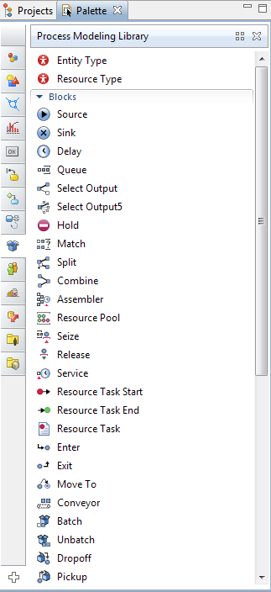

Slide 16
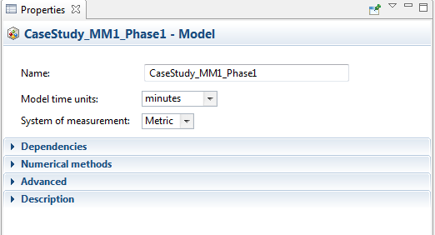
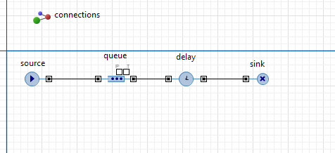

Slide 17
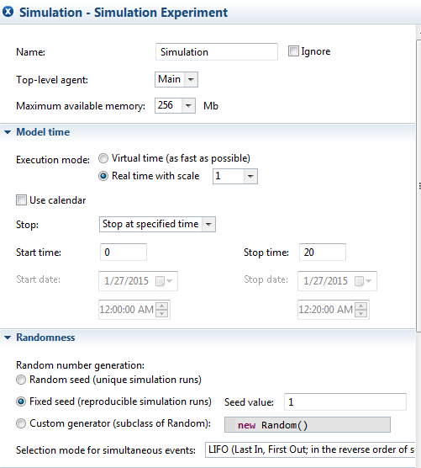

Slide 18
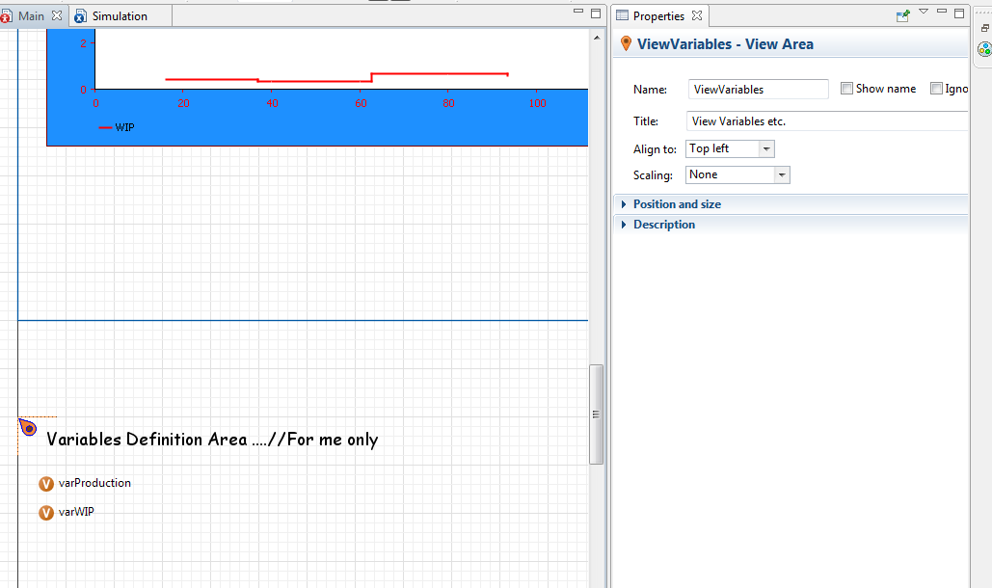

Slide 19
Phase 3+
Adding machine reliability
8% defects that need to rework
Send back to the queue
What if they need different time for processing?
E.g. uniform(5,15)?

Slide 20
SCREEN CAST

Slide 21
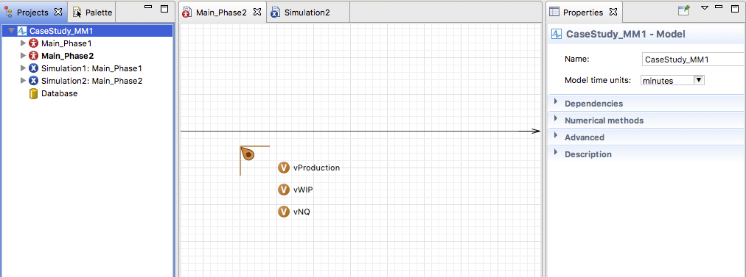

Slide 22
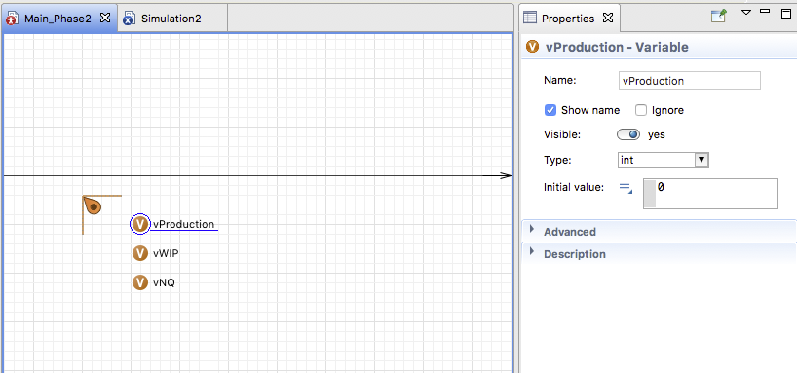

Slide 23
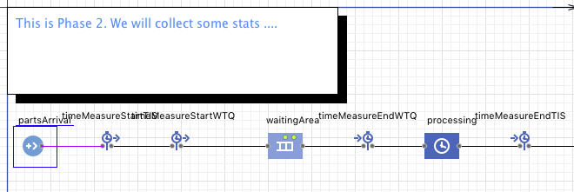
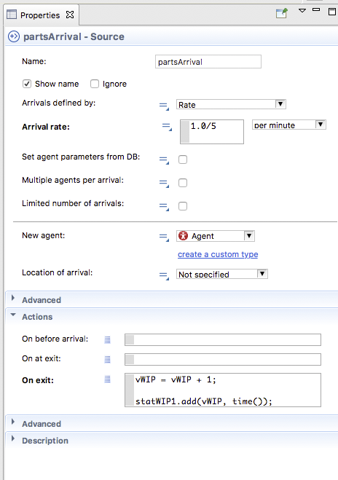

Slide 24
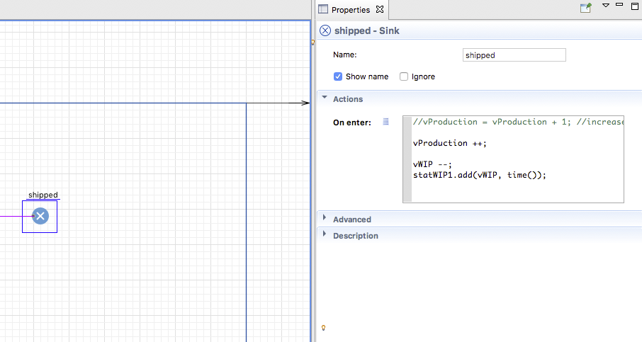

Slide 25
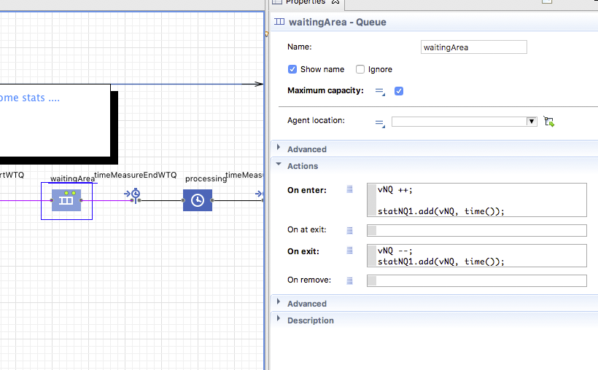

Slide 26
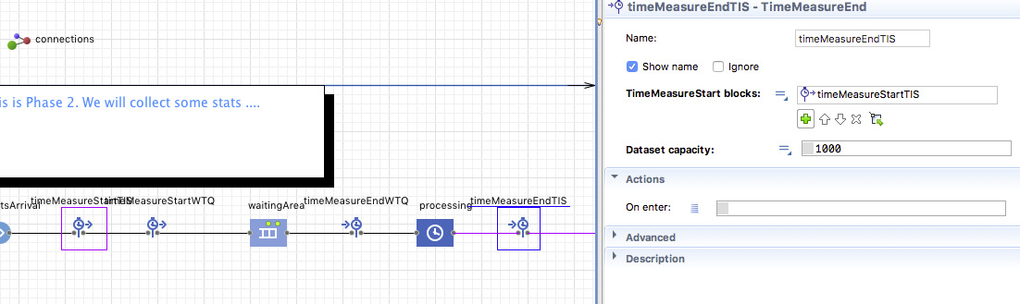

Slide 27
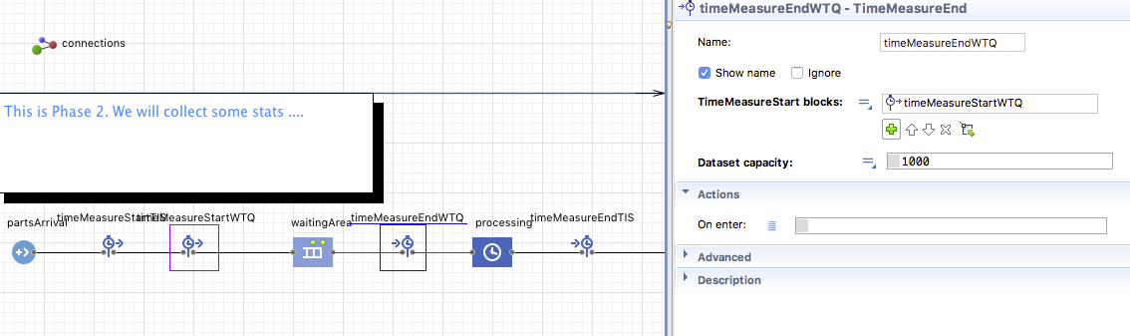

Slide 28
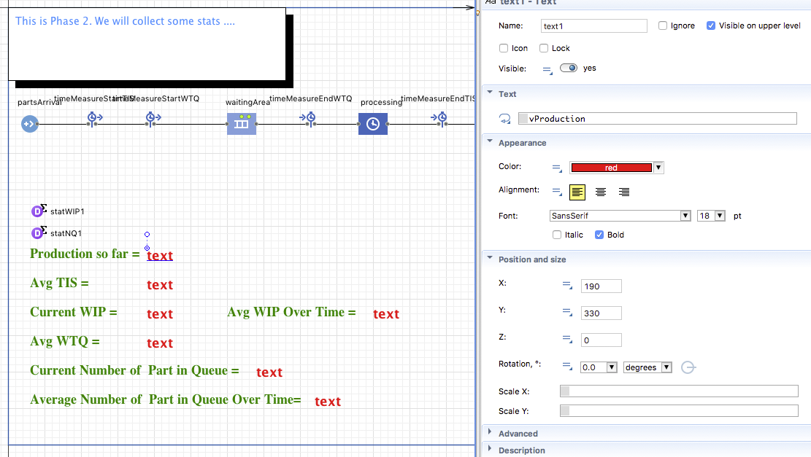

Slide 29
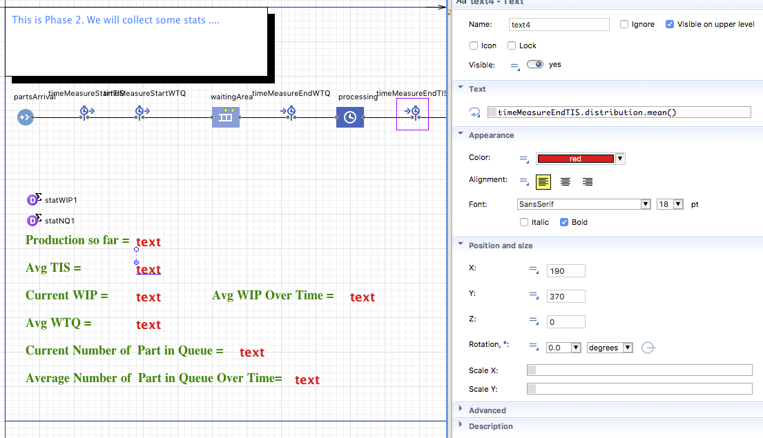

Slide 30
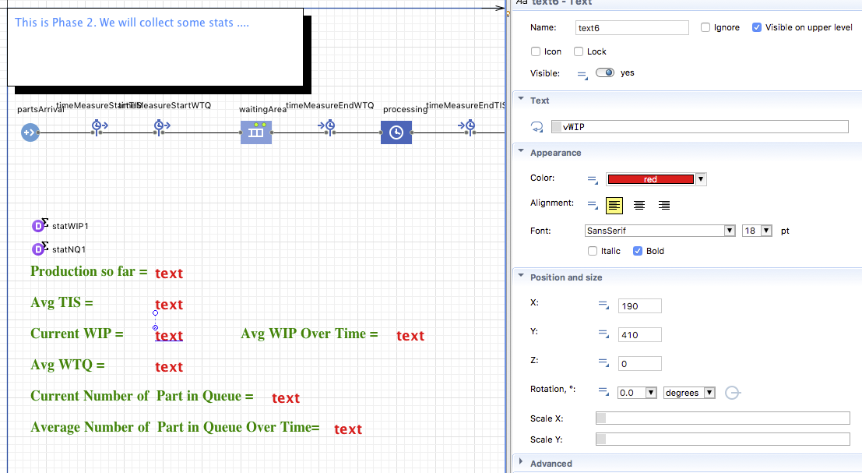

Slide 31
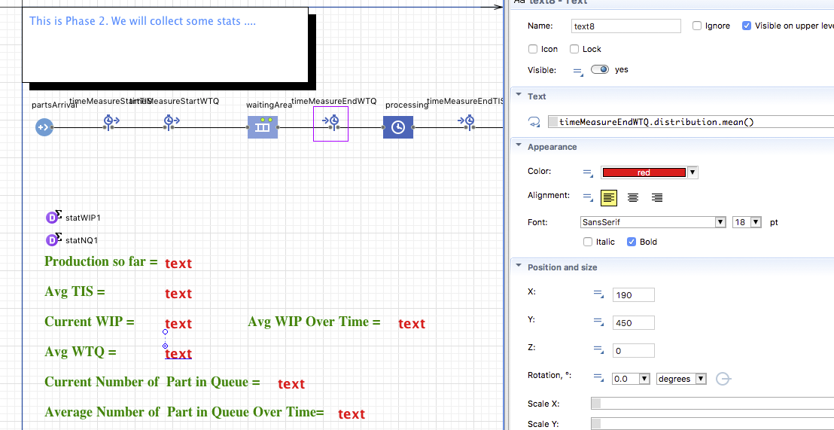

Slide 32
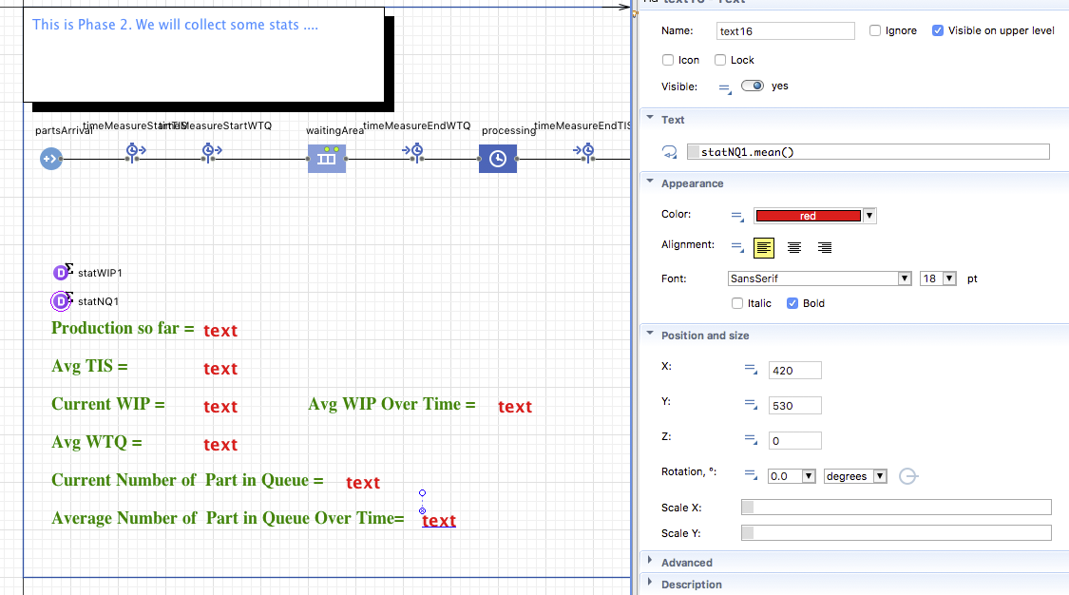

Slide 33
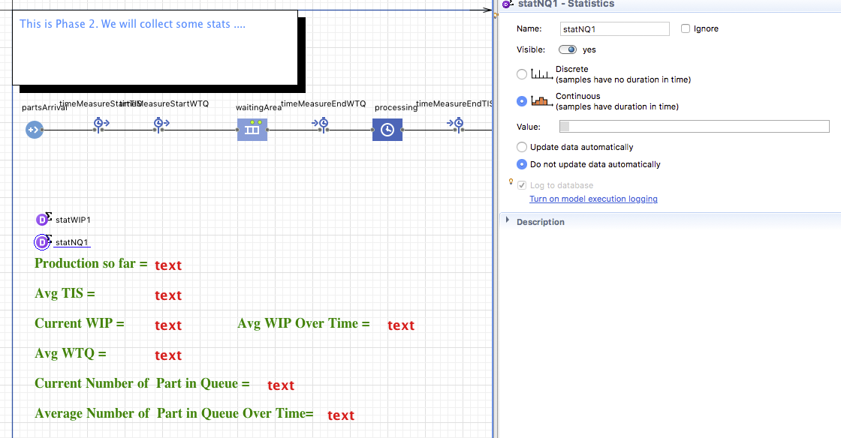

Slide 34
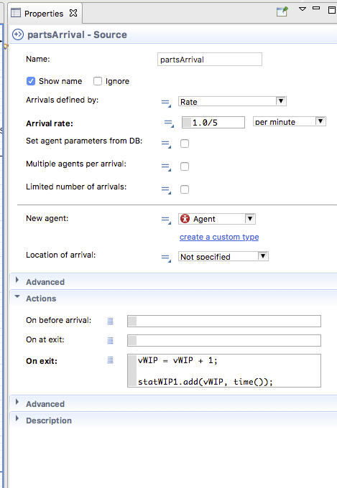
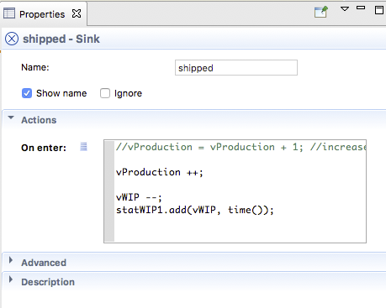
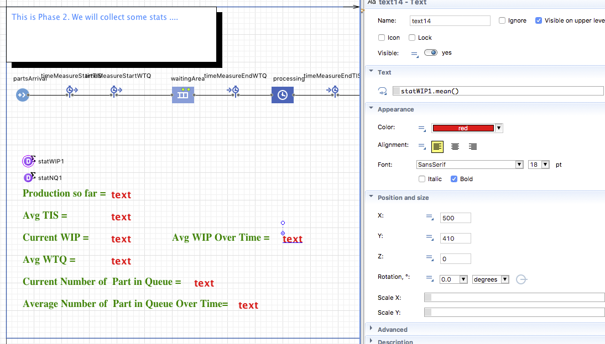

Slide 35
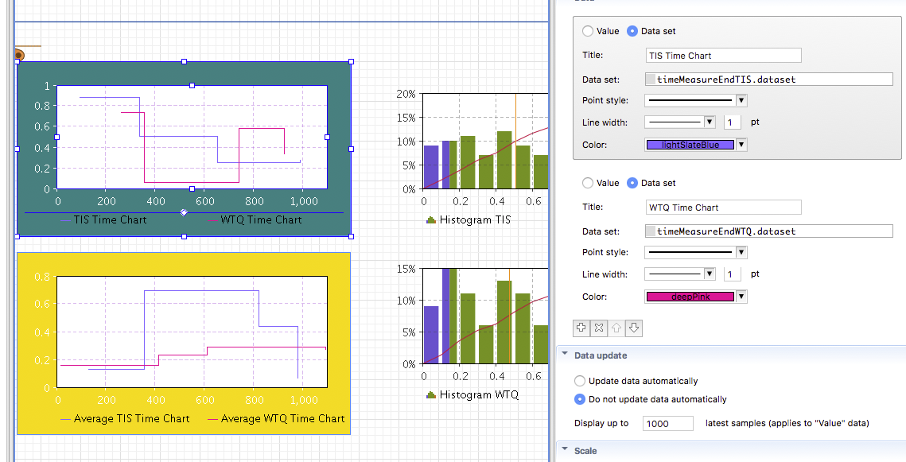

Slide 36
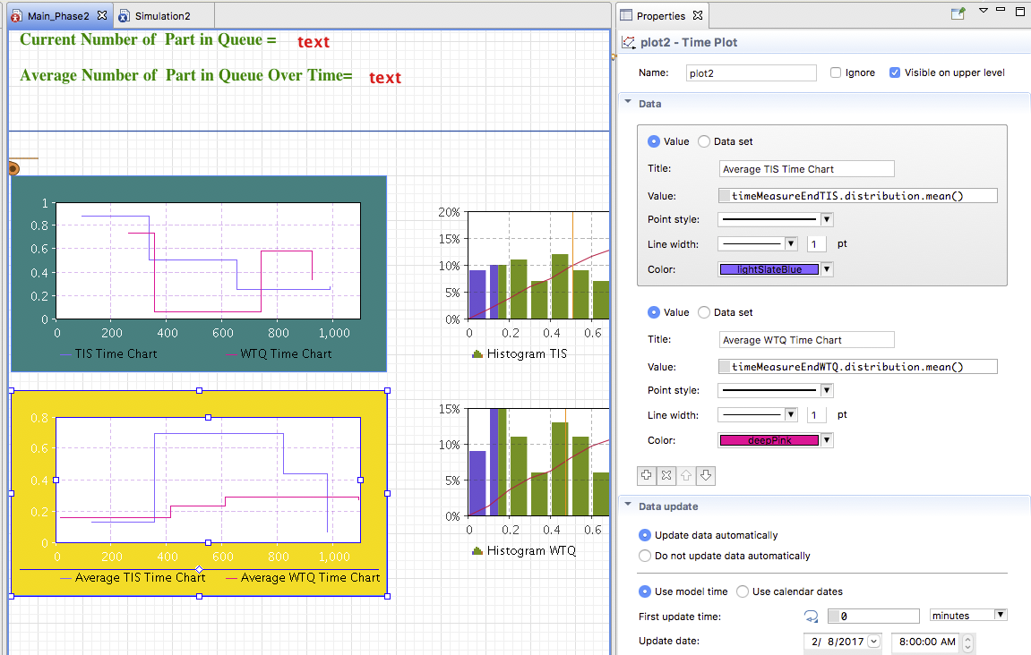

Slide 37
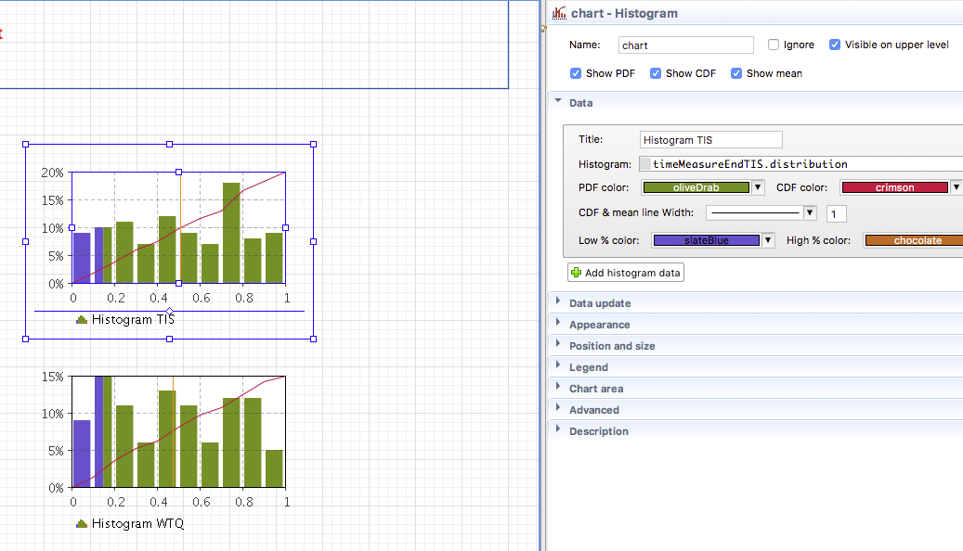

Slide 38
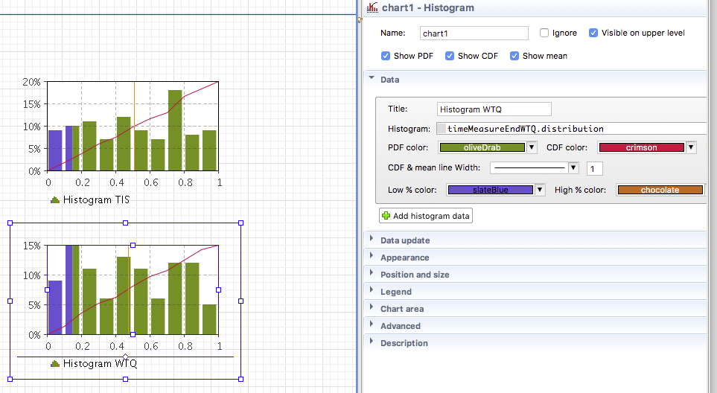

Slide 39
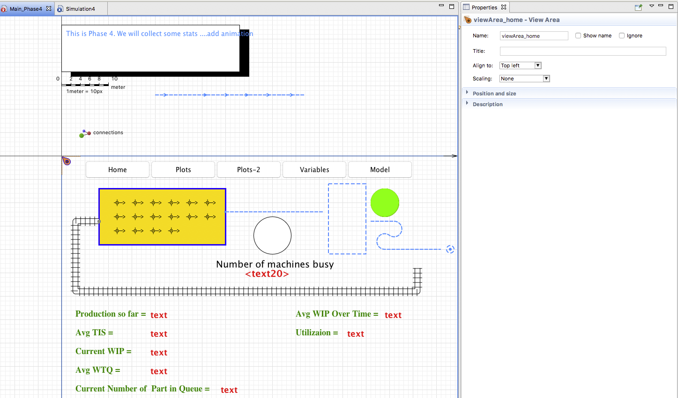

Slide 40
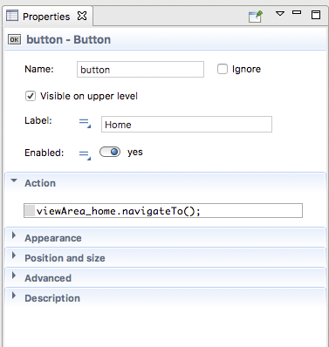
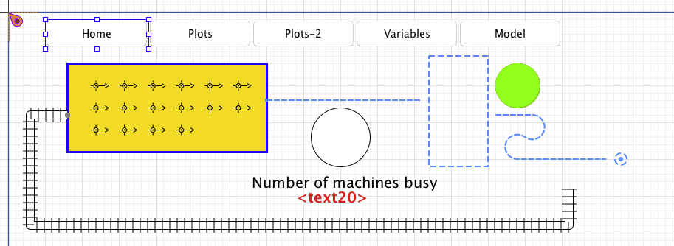
Nav bar

Slide 41
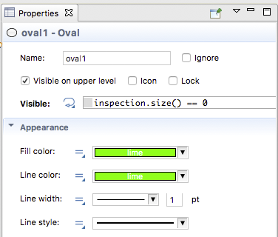
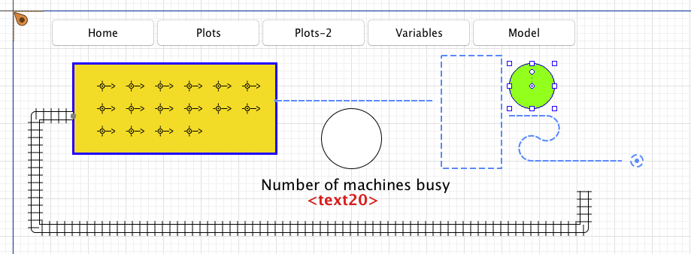

Slide 42
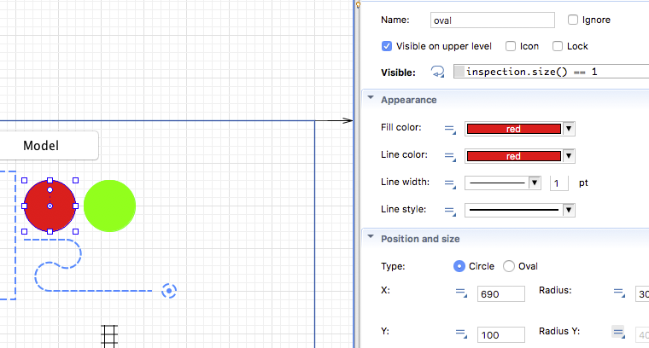

Slide 43
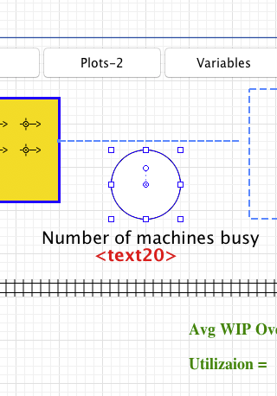
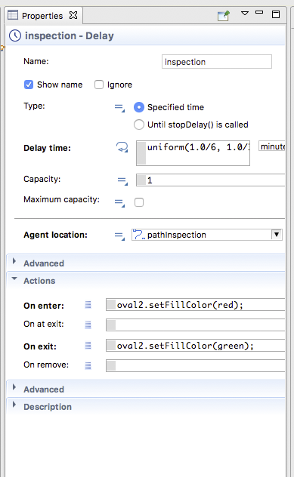

Slide 44
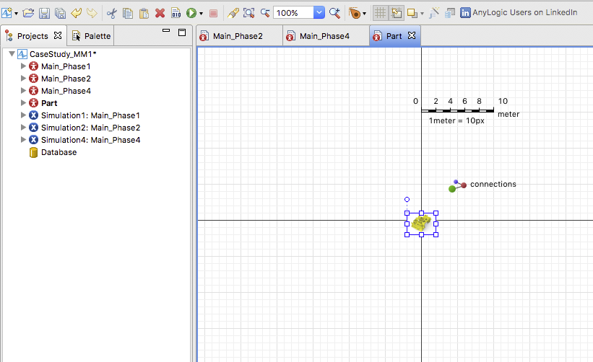

Slide 45
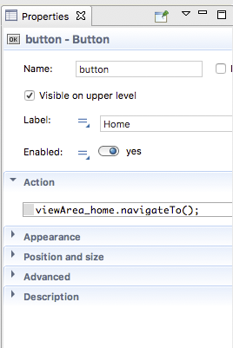
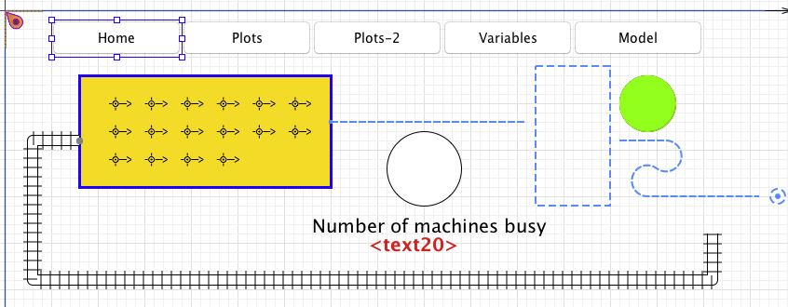

Slide 46
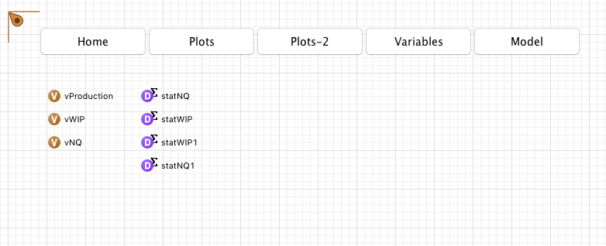

Slide 47
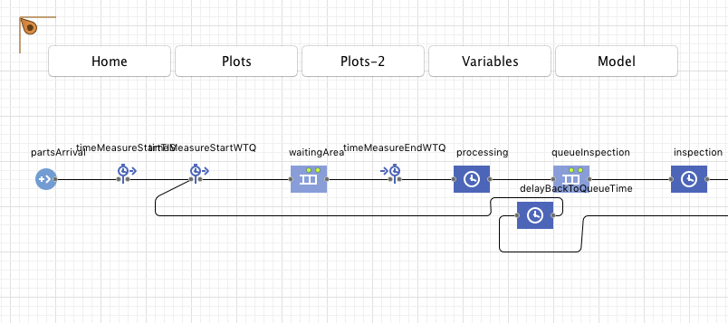

Slide 48
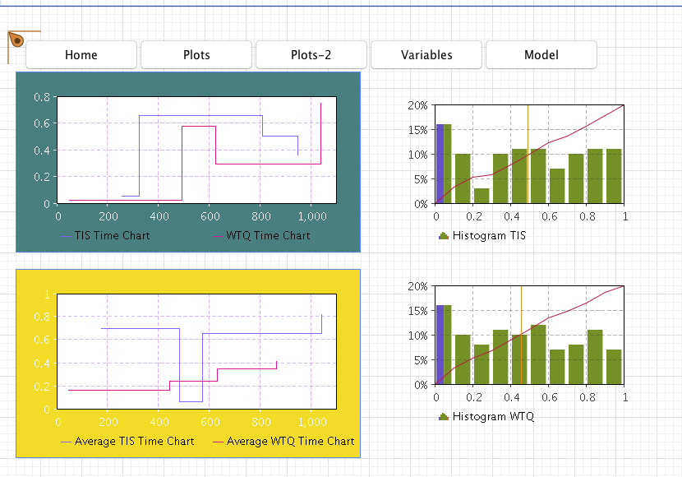

Slide 49
